Slide 1
Could Greater Bangkok Be Served by The Newly Introduced MRT Network
Dr. Yiemchai Chatkeo
2.April 2015

Slide 2
Mass Rapid Transit / Urban Rail
No. of Passengers
Reduced No. of Car Uses
Reduced Envi. Impacts
Reduced Energy Consumption
Etc.
Convenience ← Accessibility/Feeder System
Fares ← Distance
Traveling time← Distance + No. of Stops
Efficiency
= $\frac{Output}{Input}$
Costs
Capital Costs
O & M Costs
Etc.
Route Length
No. of stations

Slide 3
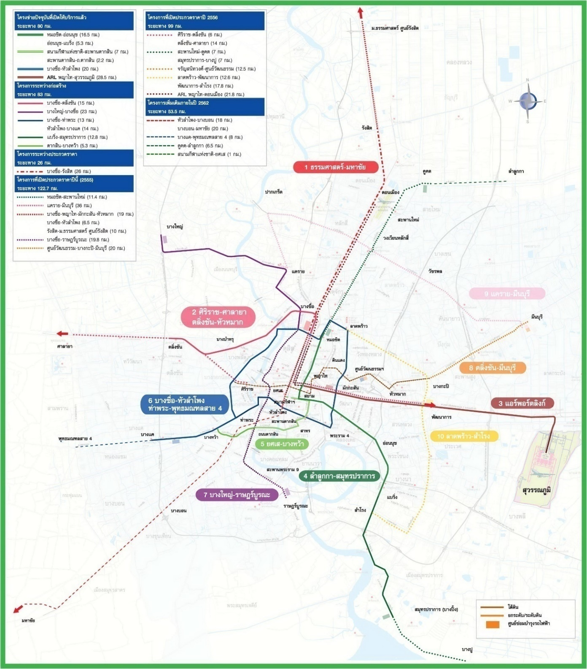
0 5 10 20 30 40 km

Slide 4
Catchment Areas
MRT: Stations every 1 km +/-
V_{max} ≈ 80 km/h
V_{average} ≈ 30 km/h

Slide 5
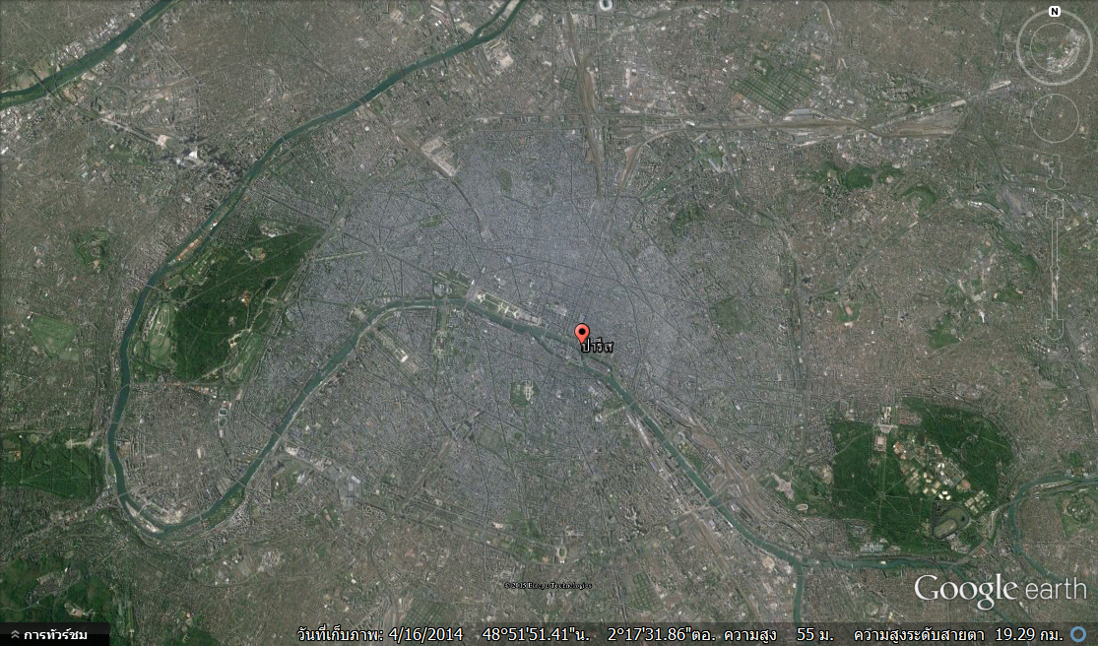
0 1 2 3 4 5 10 15 km

Slide 6
0 5 10 20 30 40 km

Slide 7
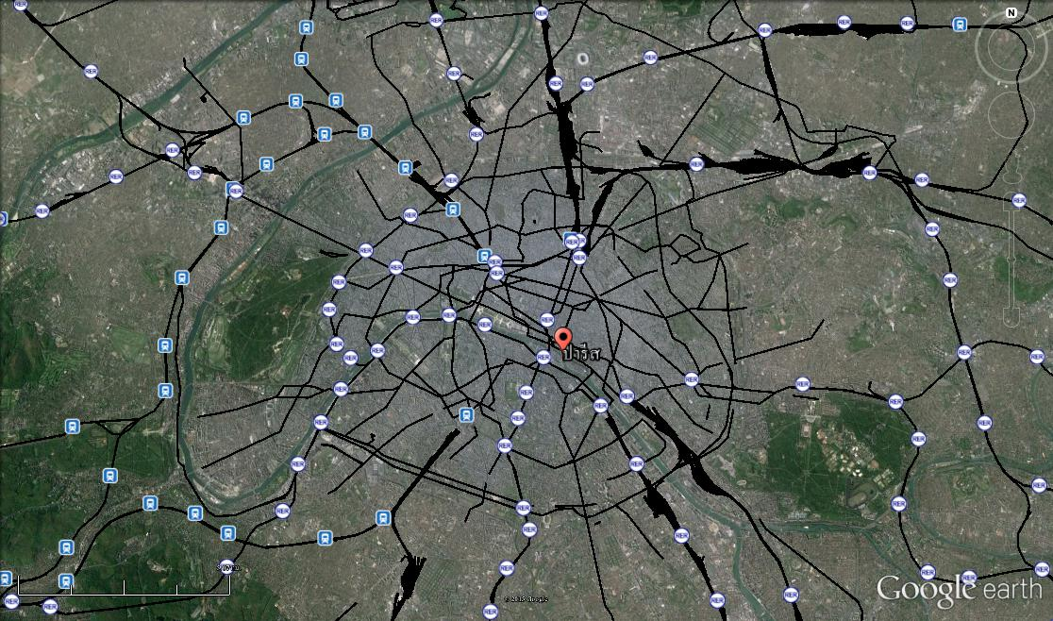
0 5 10 20 30 40 km

Slide 8
Catchment Area
MRT: Stations every 1 km +/-
V_{max} ≈ 80 km/h
V_{average} ≈ 30 km/h
Commuter Rail: Stations every 3-10 km +/-
V_{max} ≈ 120 km/h
V_{average} ≈ 50-70 km/h

Slide 9
Conclusion
It is tremendous difficult, if not impossible, to provide the greater Bangkok with efficient public/MRT system.
Good city/town planning together with good transport/traffic planning are essential for efficient public/MRT system.

Slide 10
THANK YOU

